Slide 1









Project:
Ecommerce Pearl

Slide 2
Table of Contents
Project overview
Technologies used
Database Design
File Structure
Flowcharts/Process diagrams
Screenshots
Installation guide

Slide 3
Project overview
Our project name is an ecommerce website which mainly deals in imitation jewelry, Cosmetics and Perfumes. And this project rely’s on only two modules.
Modules
Admin
Customer

Slide 4
Admin Functionalities
Manage Categories and Products:
Add new categories to the website for better organization.
Delete categories that are no longer relevant.
Add new products to the website, specifying details such as name, description, price, and images.
Delete products that are discontinued or no longer in stock.
Update Product Information:
Edit and update the information for existing products, including price, description, and images.
Database Management:
Add or delete records in the website's database, which may include information about products, users, orders, and more.
Database Backup:
Regularly create backups of the database to prevent data loss in case of system failures, hacking attempts, or other unforeseen events.
Generate/View Top 10 Best Selling Products Report:
Generate and view reports that list the top 10 best-selling products, which can help in assessing product popularity and optimizing sales strategies.
Generate/View Top 10 Clients/Users Report:
Generate and view reports that identify the top 10 clients or users who are making the maximum number of purchases on the website. This information can be useful for customer engagement and marketing strategies.

Slide 5
Customer Functionalities
Browse Categories and Products:
Explore and navigate through the available categories and products on the website.
Add Products to Shopping Basket:
Select products of interest and add them to the shopping basket or cart for potential purchase.
Specify Quantity:
Set the desired quantity for each selected product within the shopping basket.
Complete/Finalize Order:
Proceed to complete and finalize the order by providing necessary information.
Search Products by Name:
Utilize the search functionality to find specific products by name or keywords.
Track Order:
Access order tracking features to monitor the status and delivery progress of their placed orders. This may include estimated delivery times and shipment tracking information.
Product Reviews:
Provide product reviews after completing an order. Customers can:
Submit a review with their thoughts on the purchased product.
Update their review at a later time to reflect any changes in their opinion.
Delete their review if they no longer wish to have it displayed.

Slide 6









Technologies used
As Our Project has full stack functionality app so we have used frontend+backend technologies.
Front-end
Back-end
Plugins

Slide 7
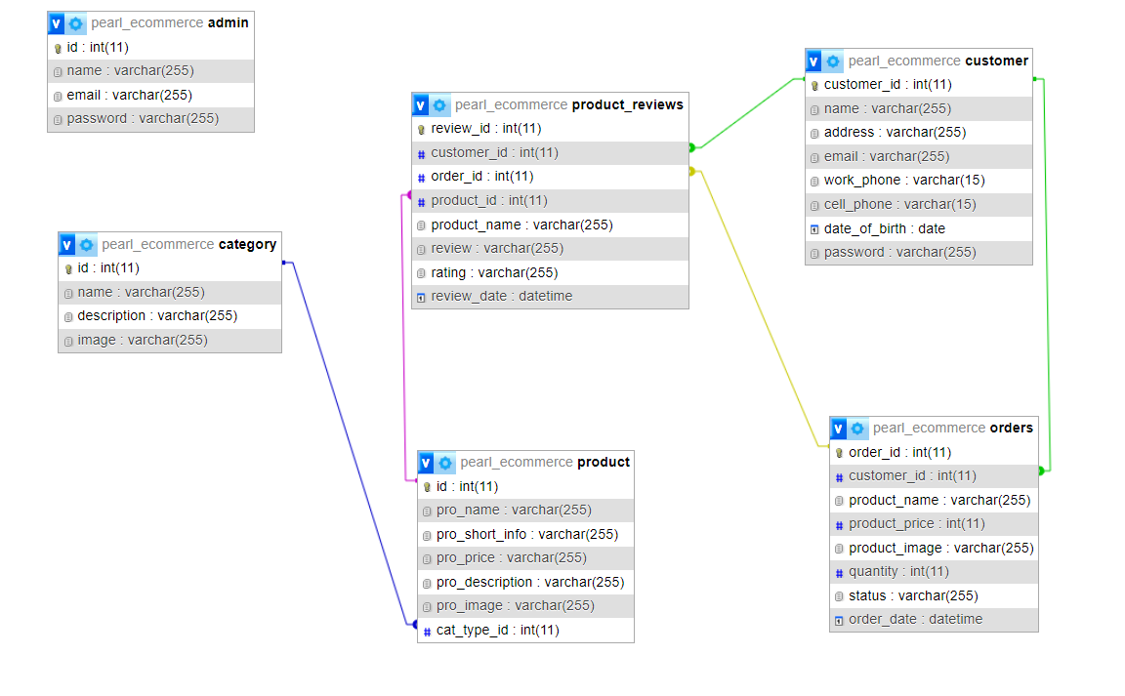
Database Design

Slide 8
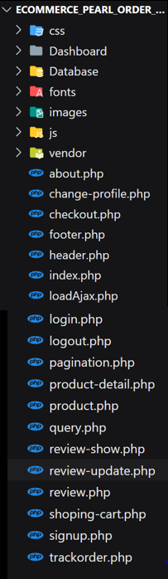
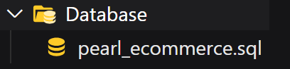
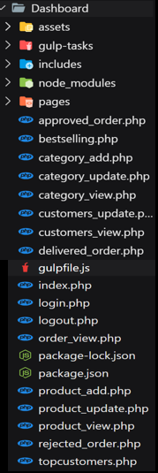
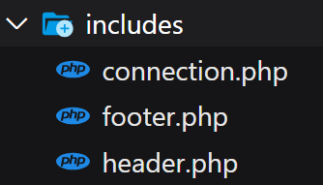
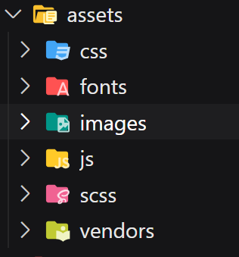
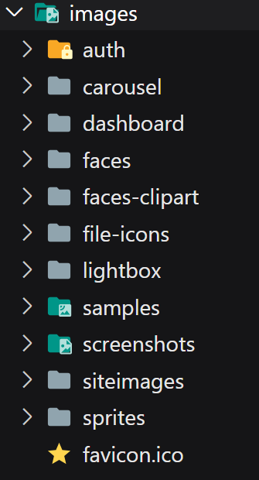
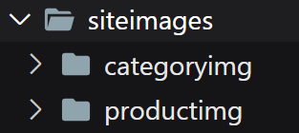
File structure
This folder contains database file
Dashboard/assets
assets/images
Dashboard files
Ecommerce website files
These php files
Connection.php is used up by
images/siteimages
These php files

Slide 9
Flowchart/Process diagram
Admin Perspective
1)Entering website url in search bar
Website URL/Dashboard
3)Redirected to Dashboard
Dashboard main page
Add/View/Update/Delete/Category
2)Redirected to login page
Add/View/Update/Delete Product
Login page
View/Update/Delete Customers
If values correct
View/Accept/Reject/change status of orders
If values incorrect
View Top 10 Best Selling products
View Top 10 Customers

Slide 10
Customer Perspective
Redirected to Signup page
1)Entering website url in search bar
Signup Page
Website URL
After login customer has access to
If already have any account
Track his/her order
If don’t have any account
2)Redirected to website main page
Submit/edit/delete his/her review
Redirected to login page
Main Page
Change his/her profile
Login Page
If not logged in already
Products to checkout process
Products page
Product details page
Cart page
Checkout page
Here you can add product to cart
If customer wish to update cart
If already logged in
And customer would be redirected to products page again
Then order would be placed
Redirected to Main page
And would be redirected to cart page

Slide 11
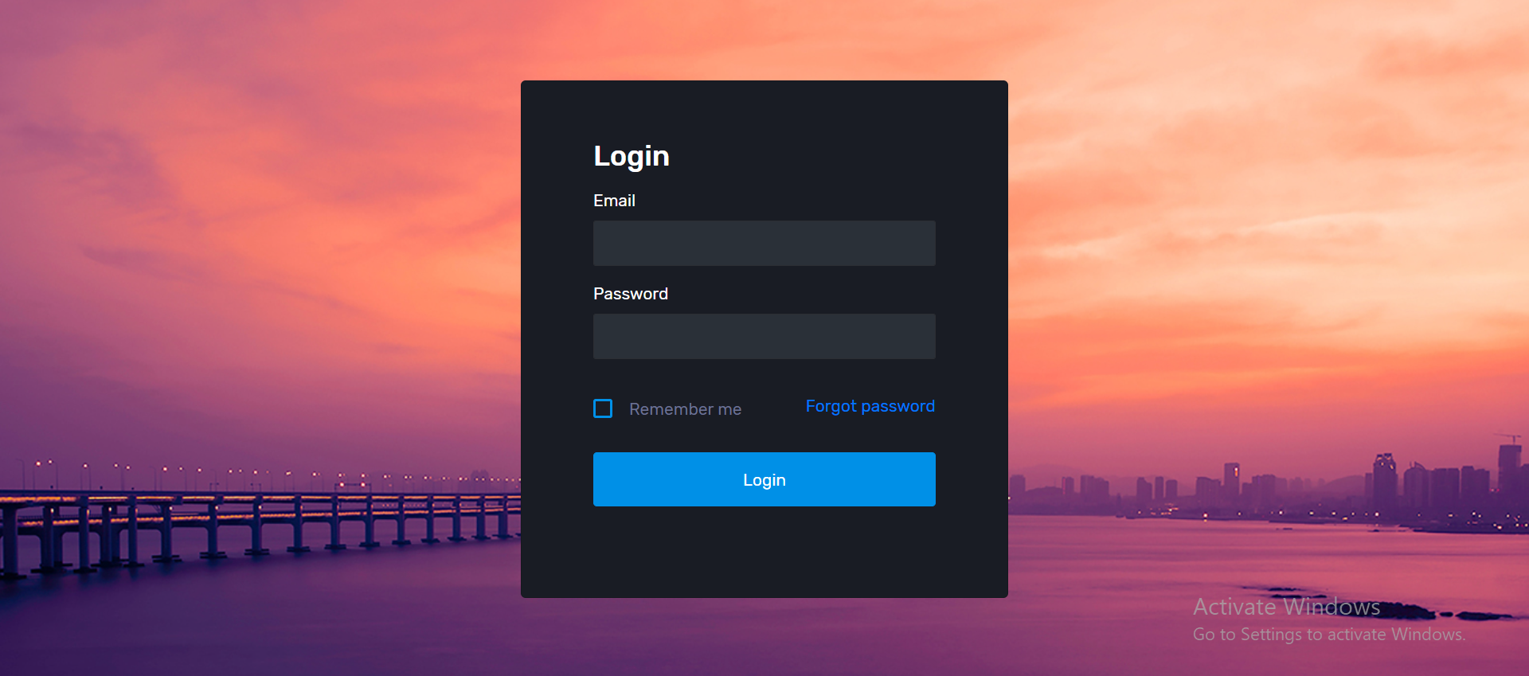
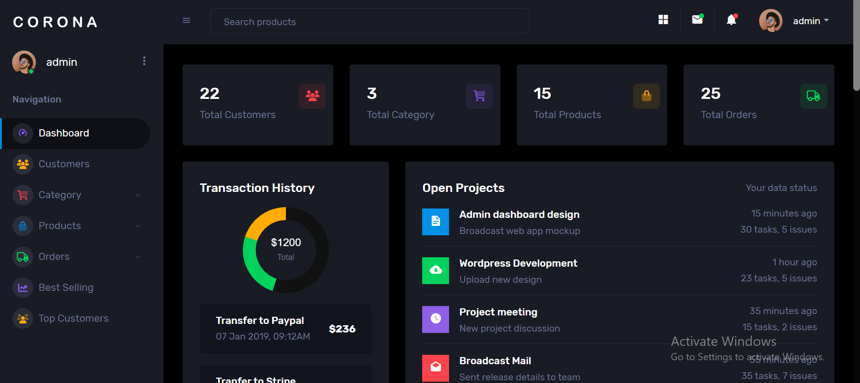
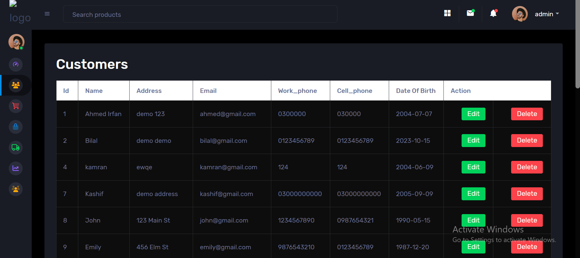
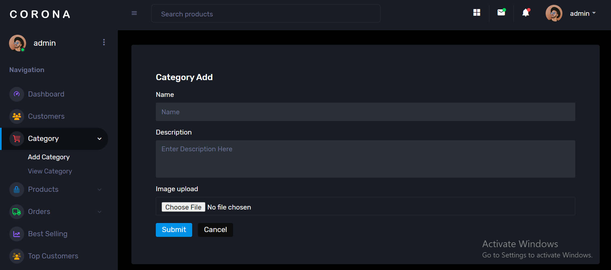
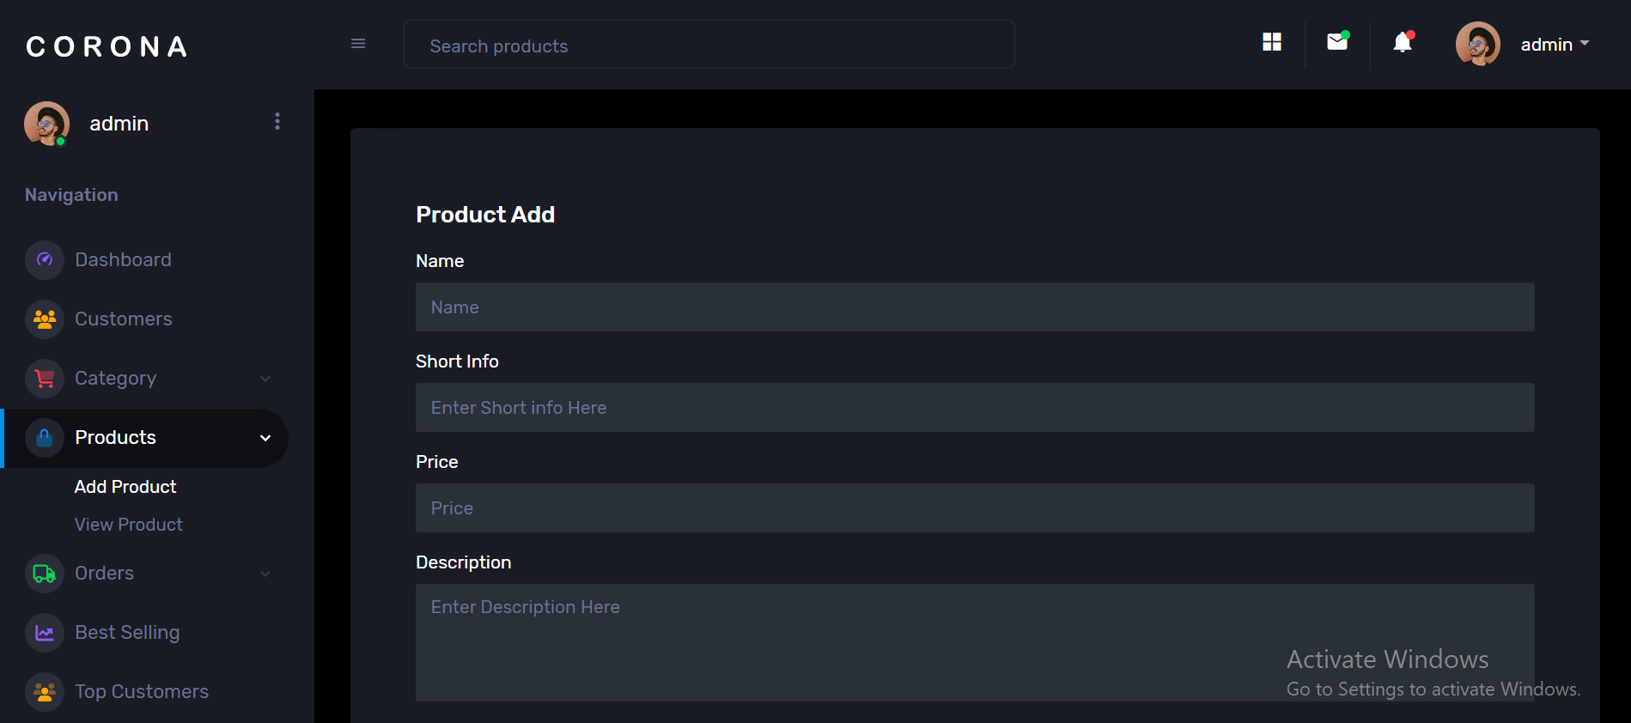
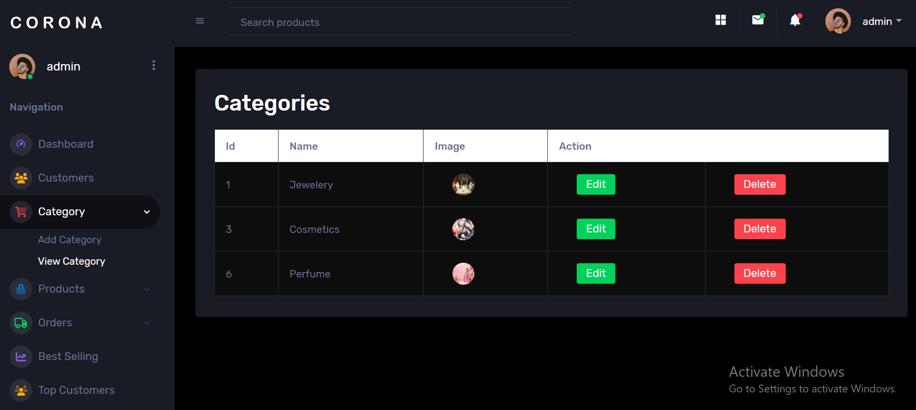
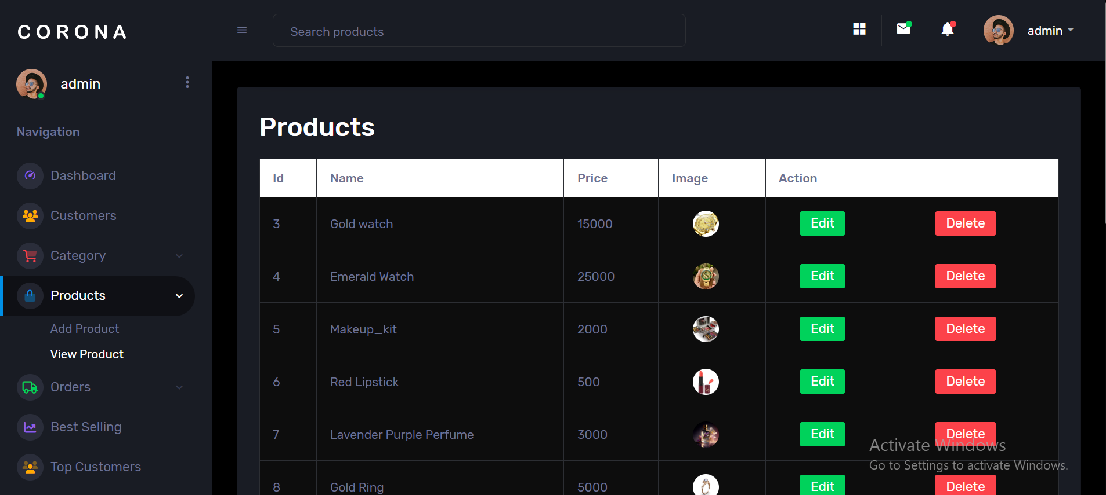
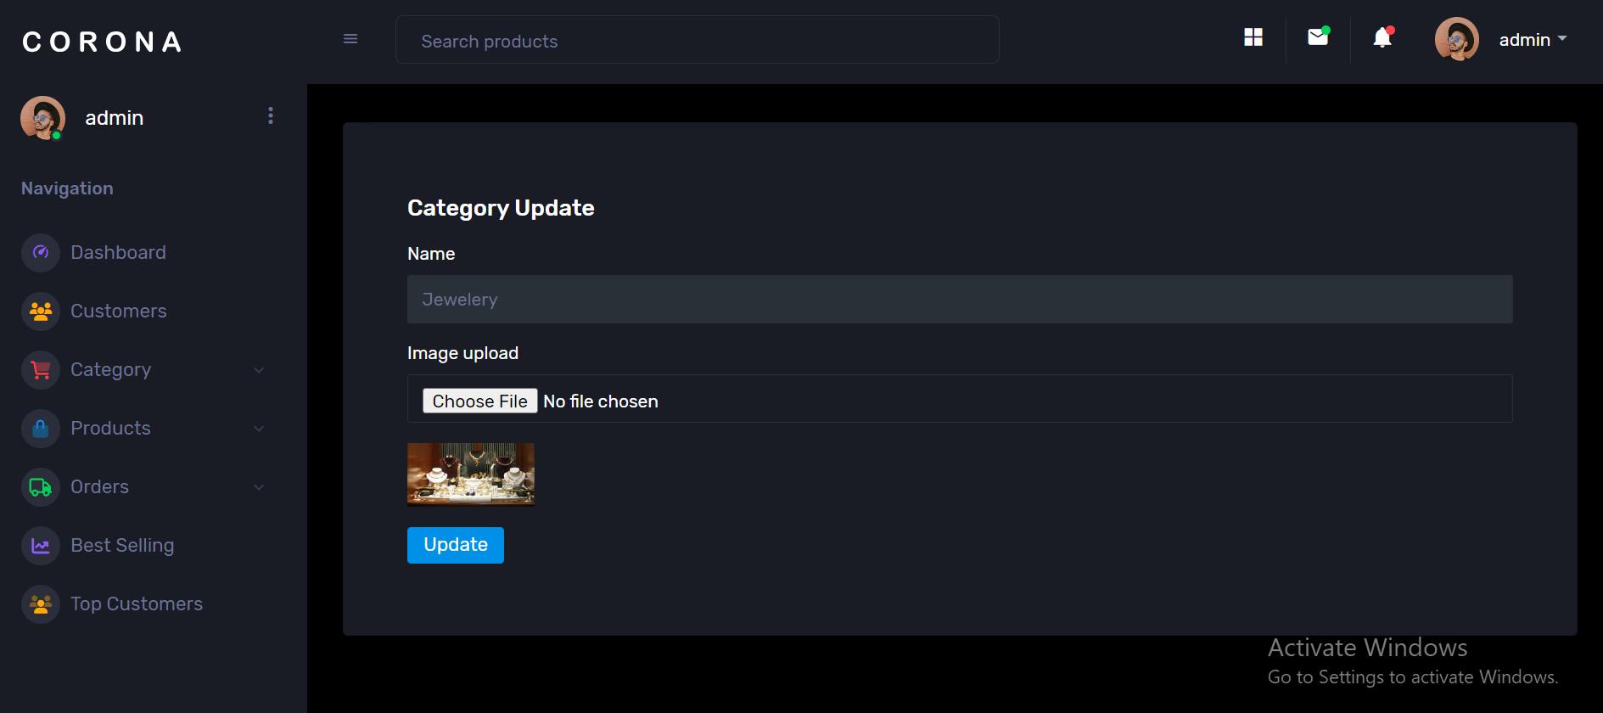
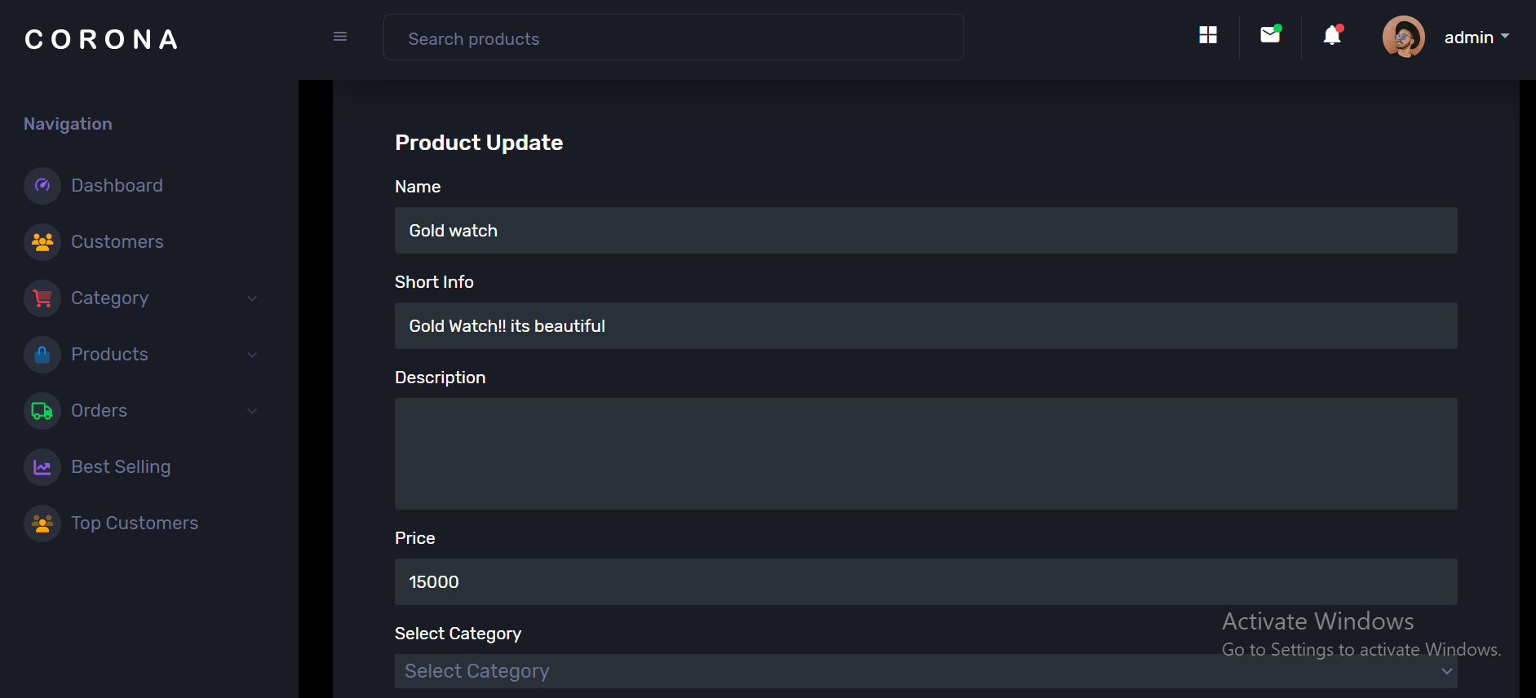
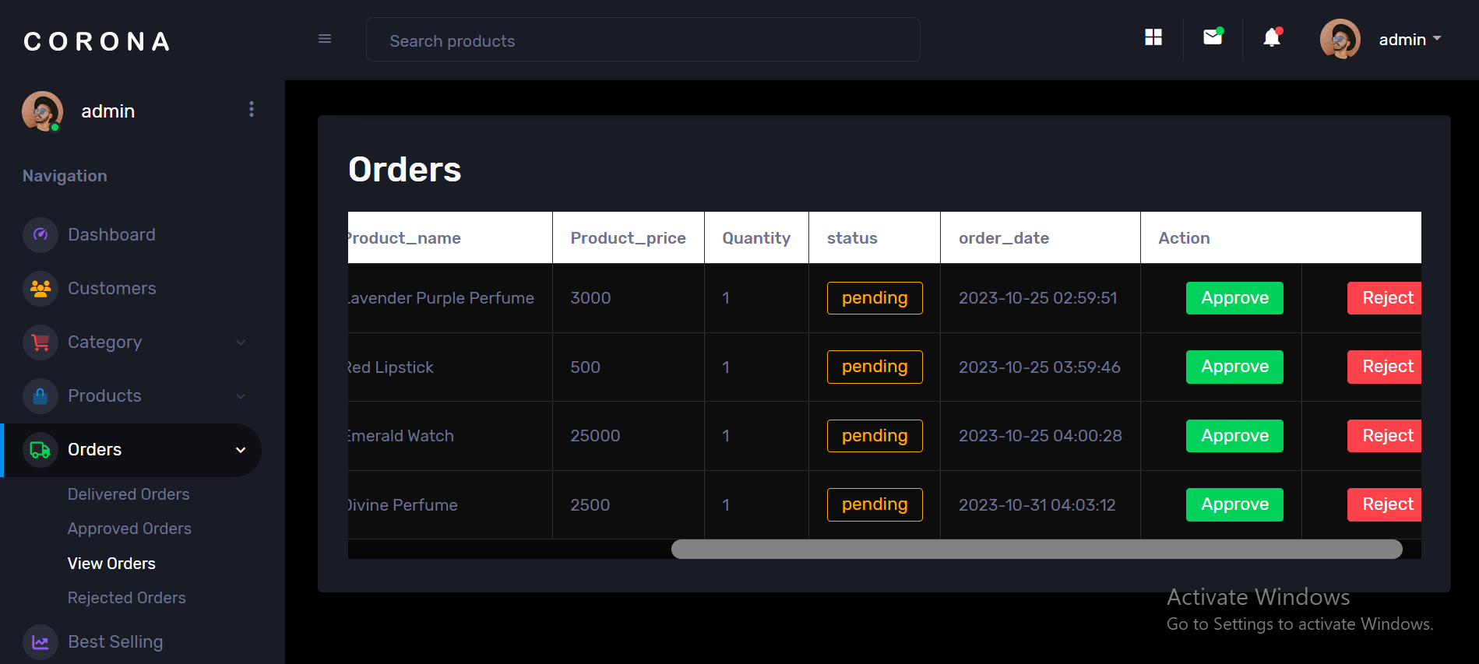
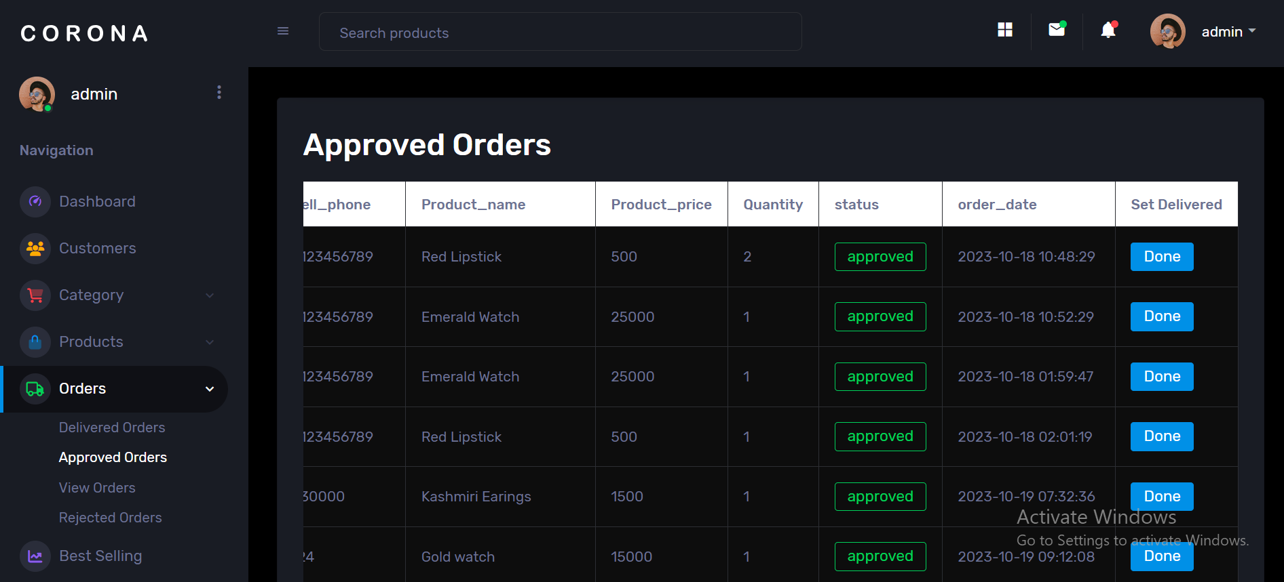
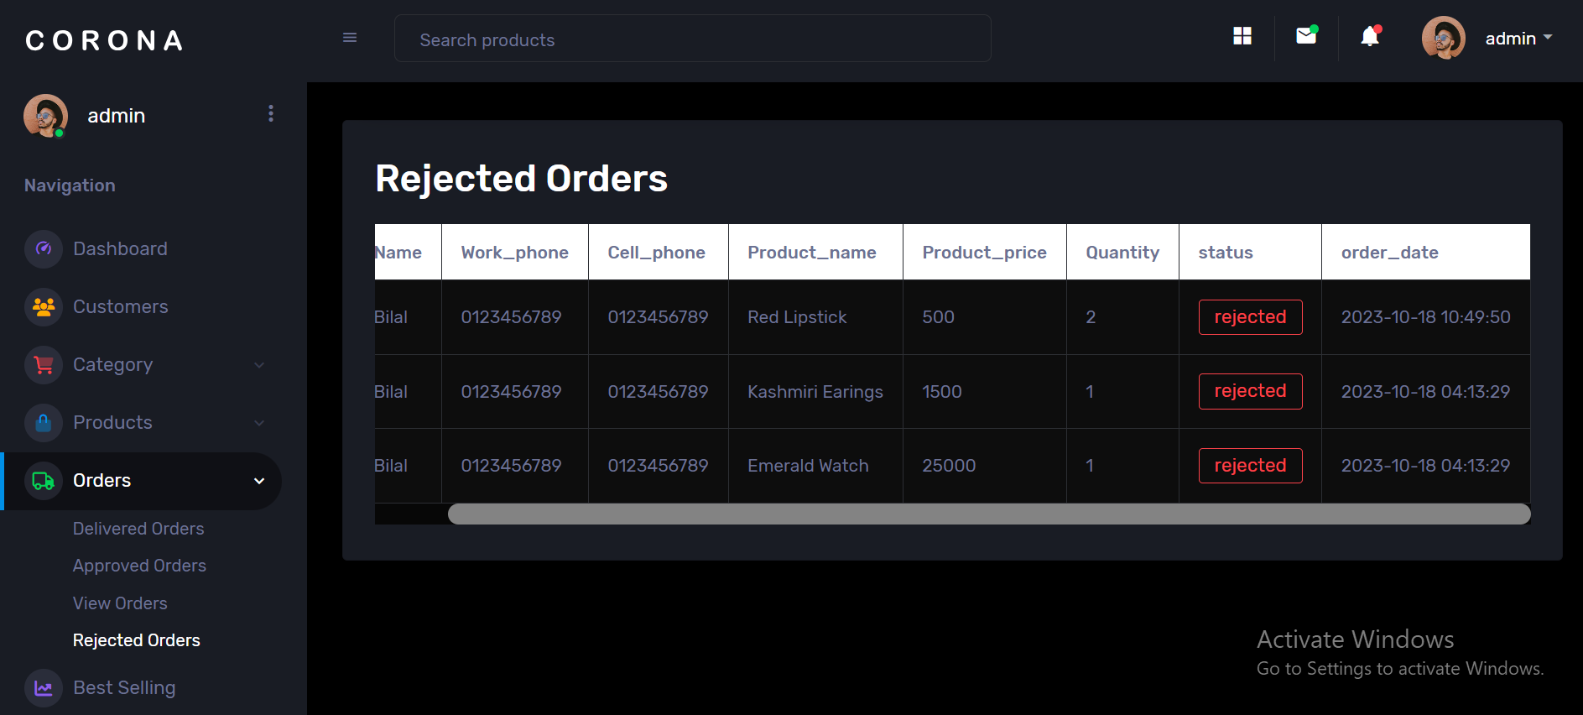
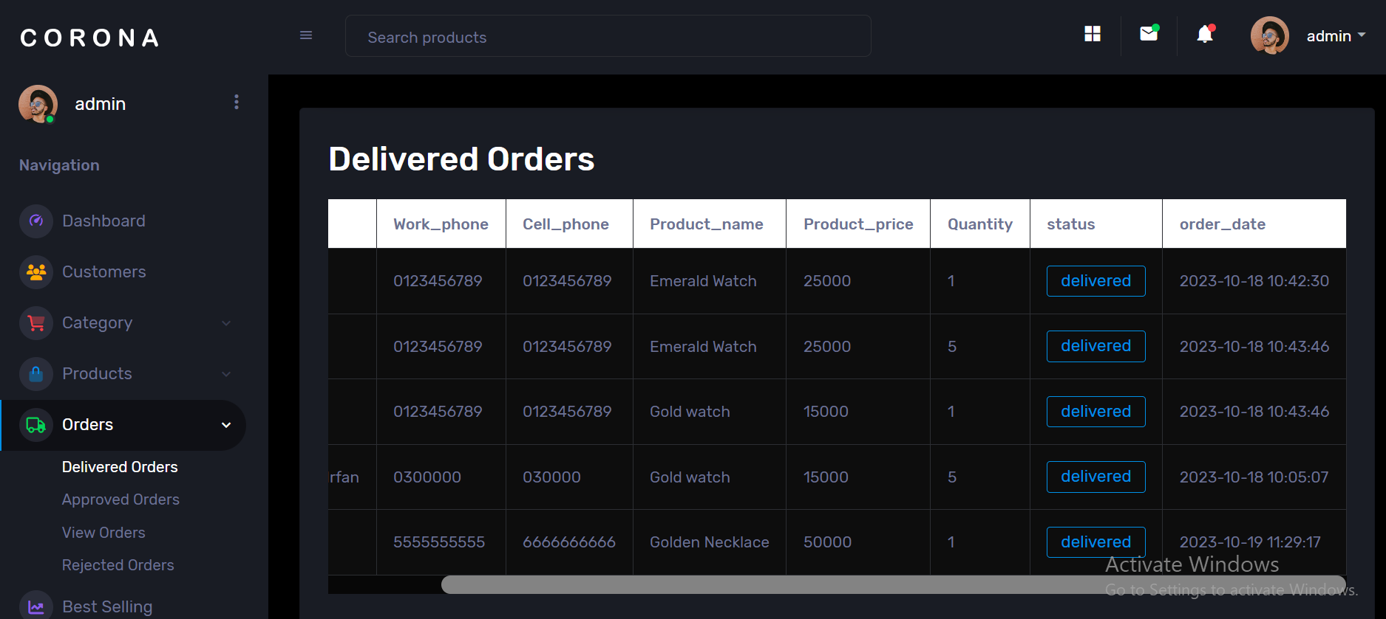
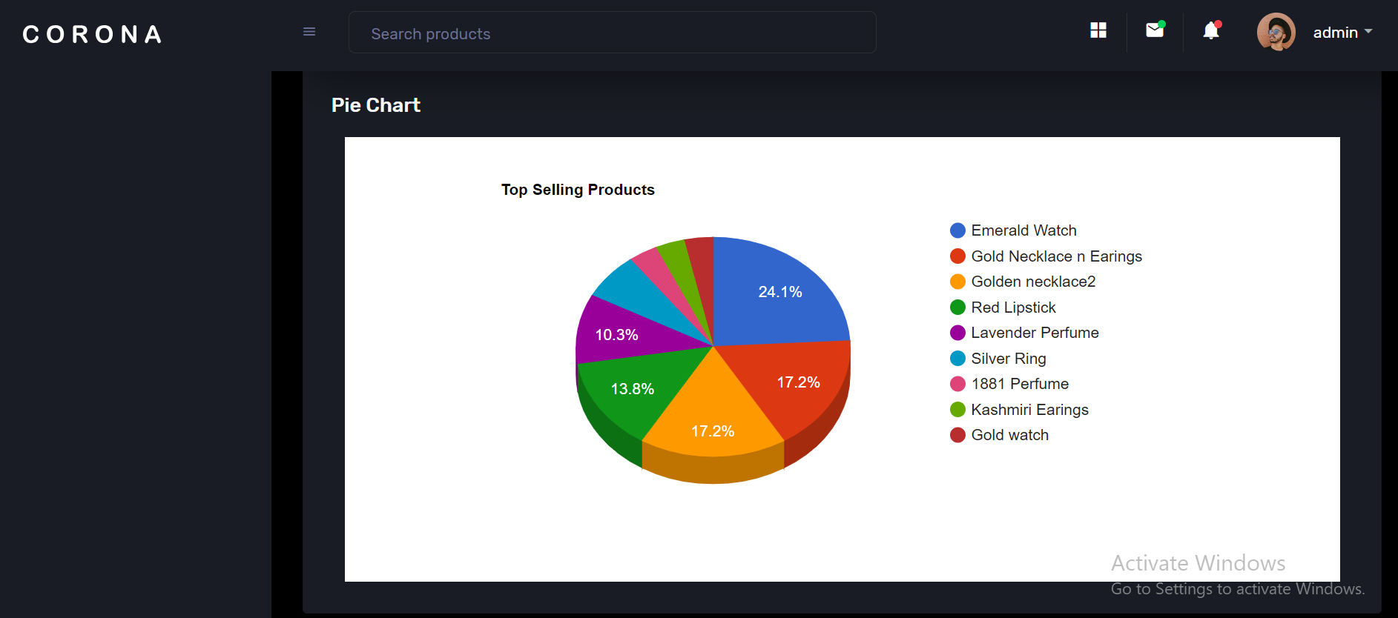
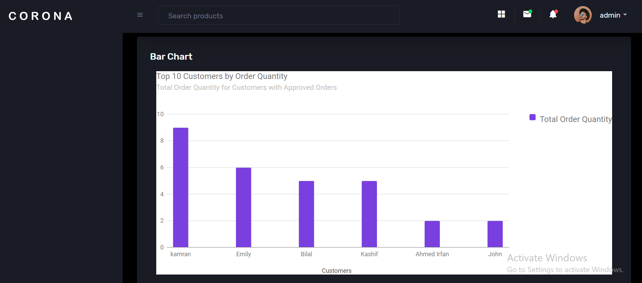
Screenshots
Dashboard
Login page
Dashboard’s main page
Customers view page
Category add page
Products add page
Category view page
Products view page
Category update page
Products update page
Orders view page
Approved orders page
Rejected orders page
Delivered orders page
Top 10 best selling products
Top 10 best customers

Slide 12
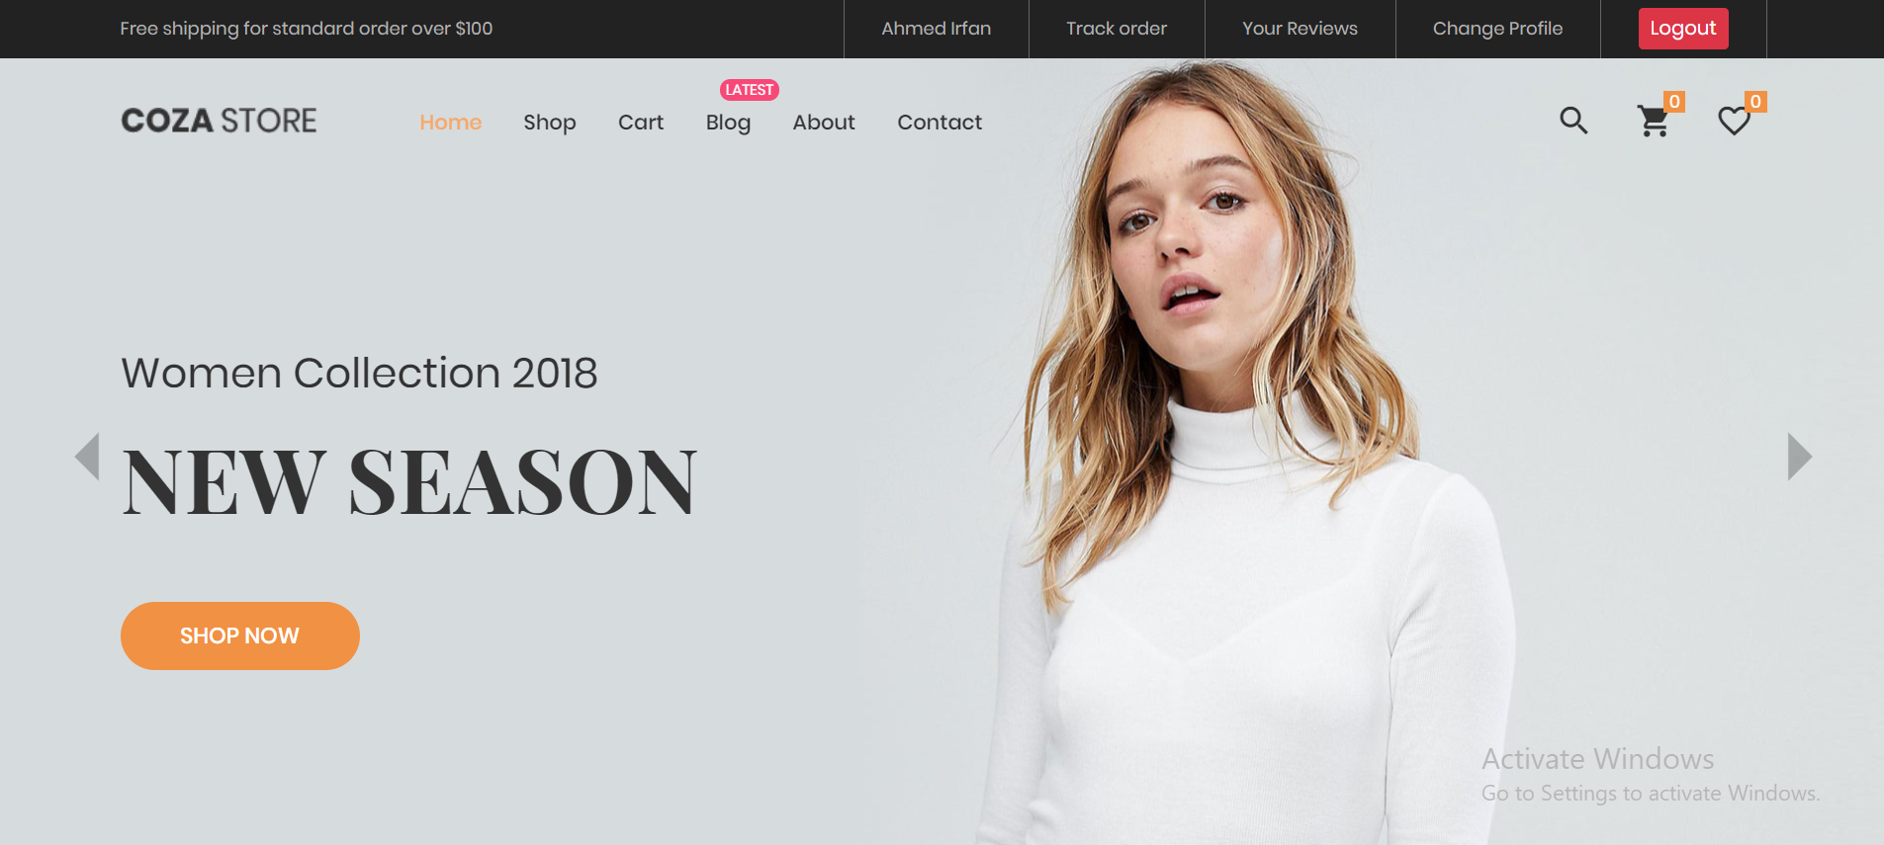
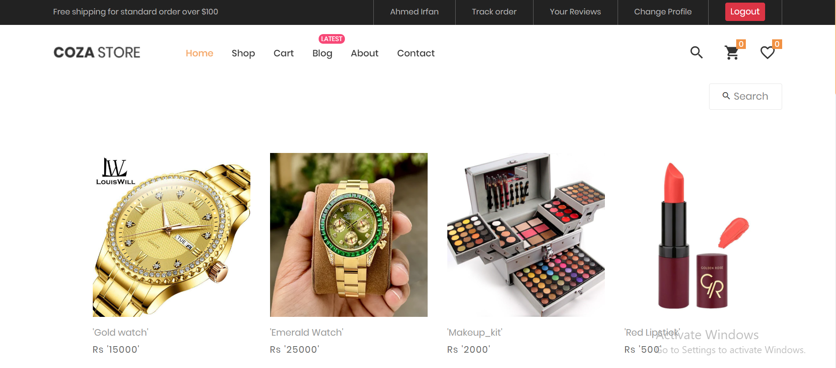
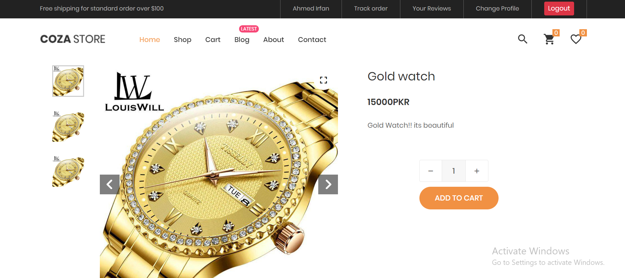
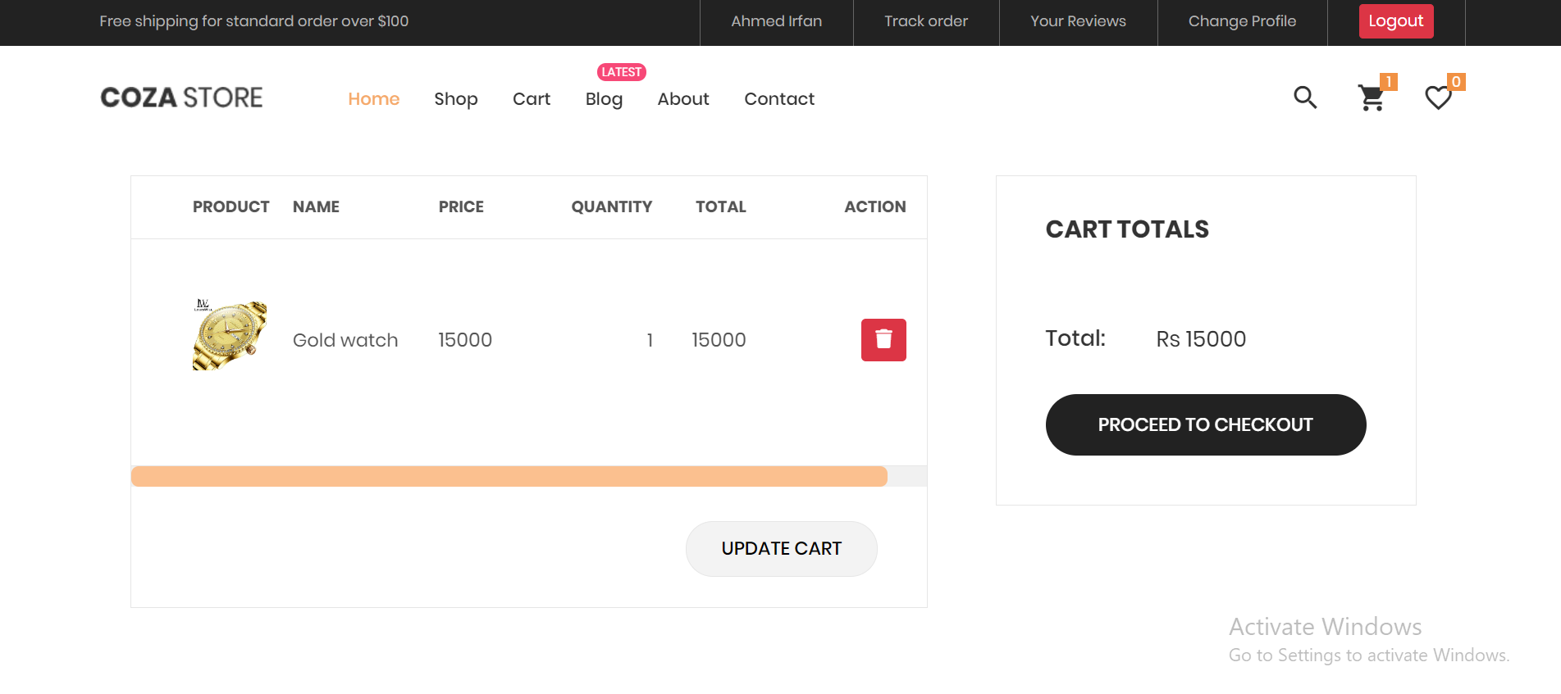
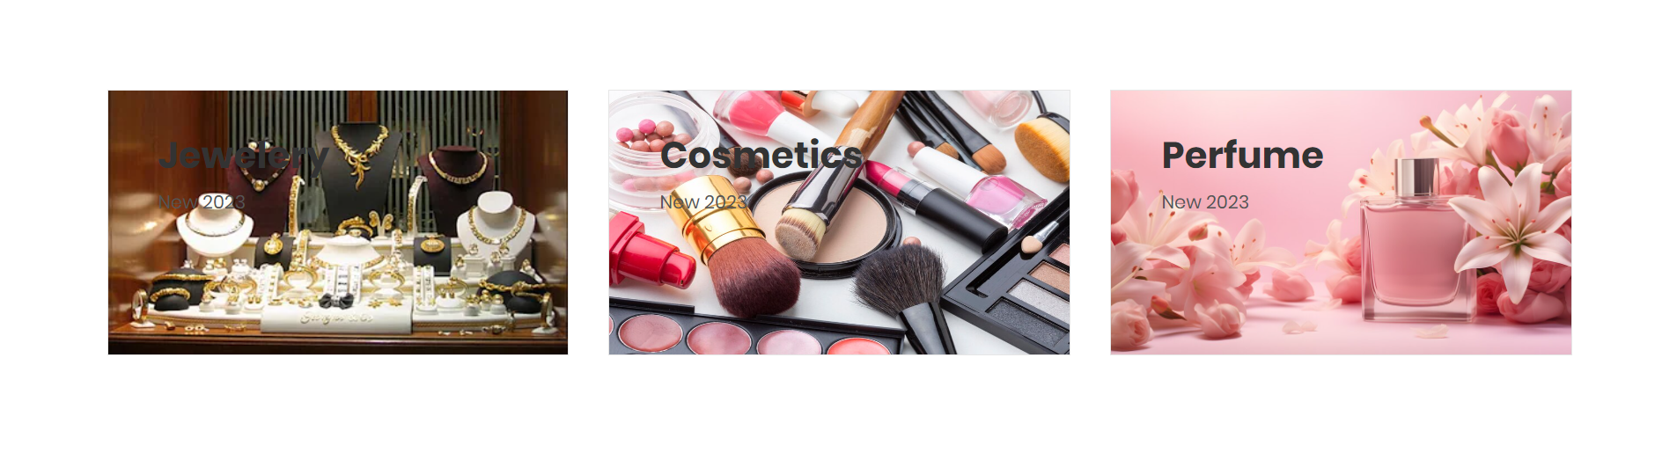
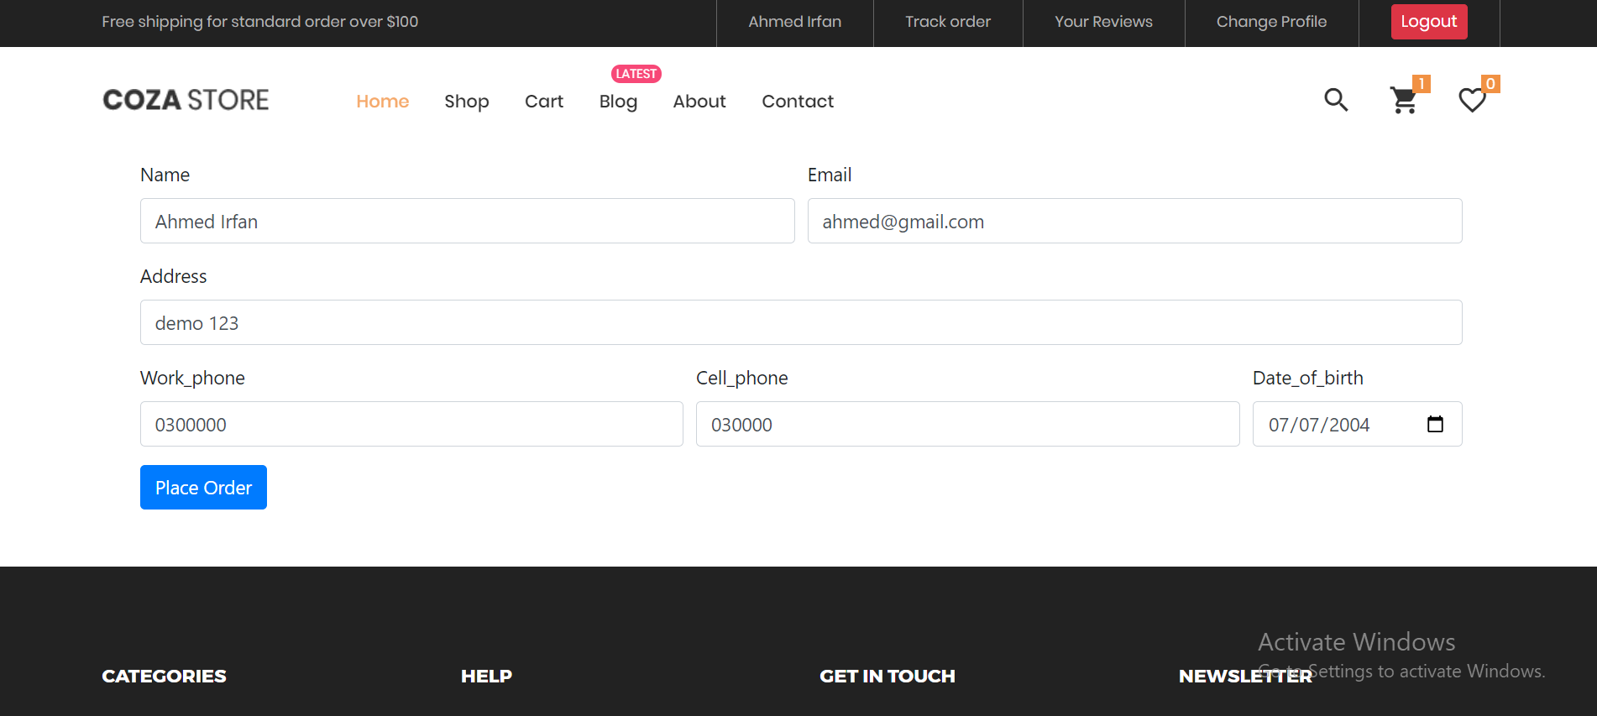
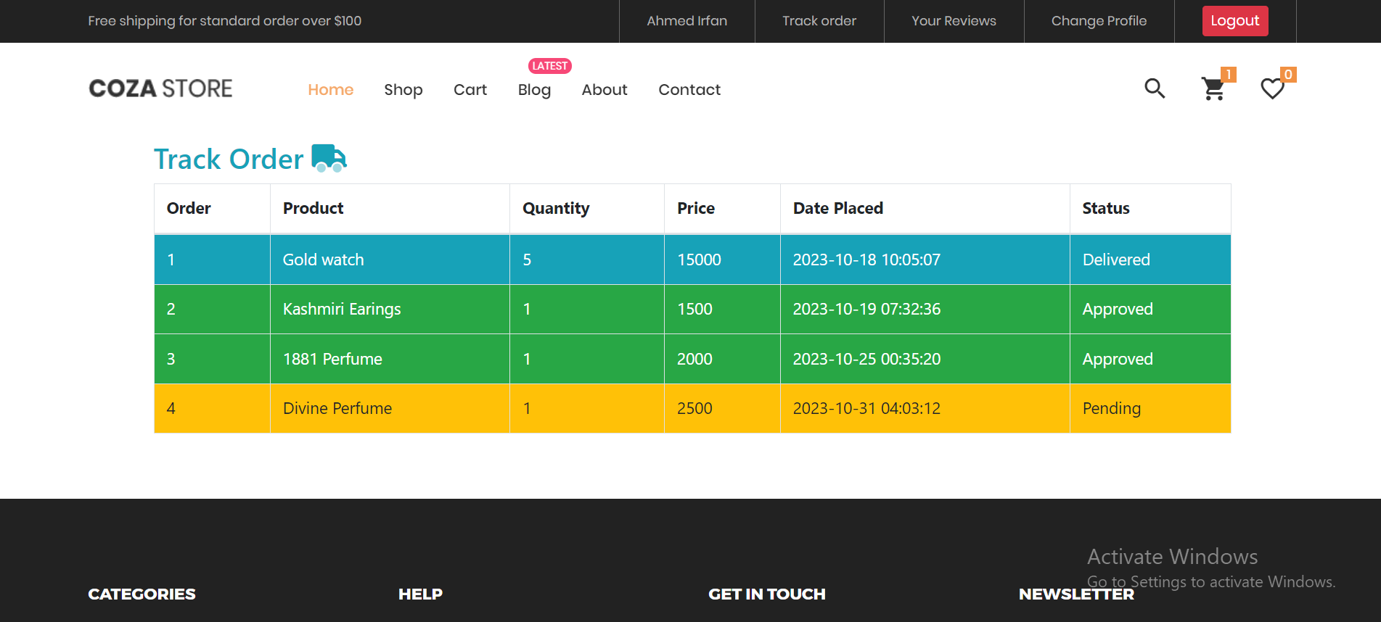
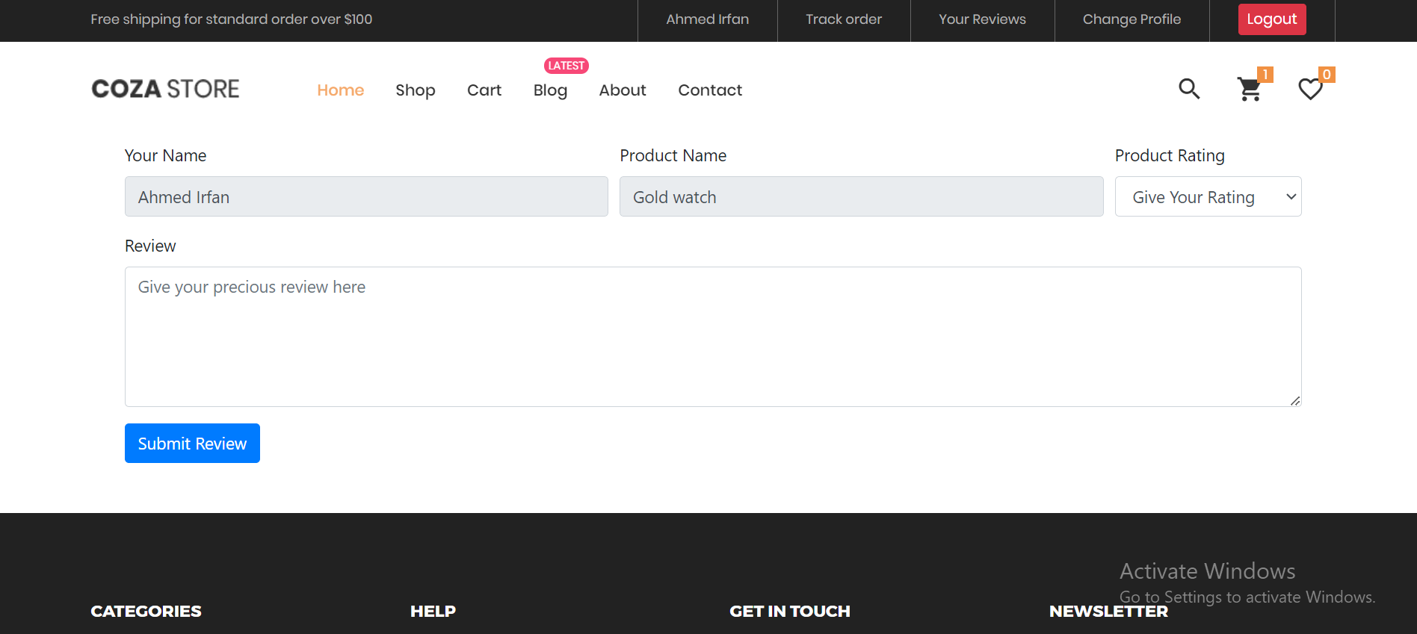
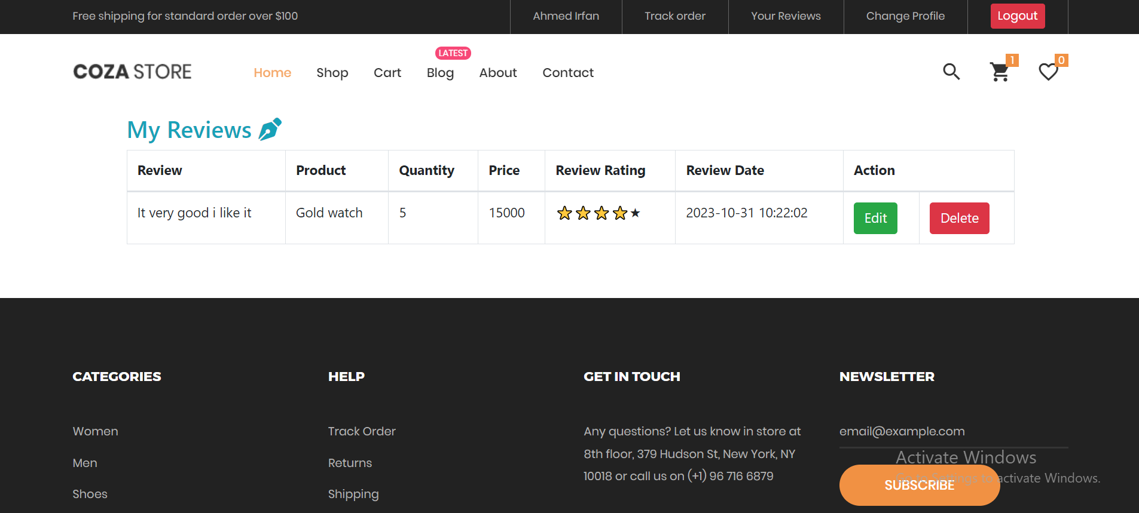
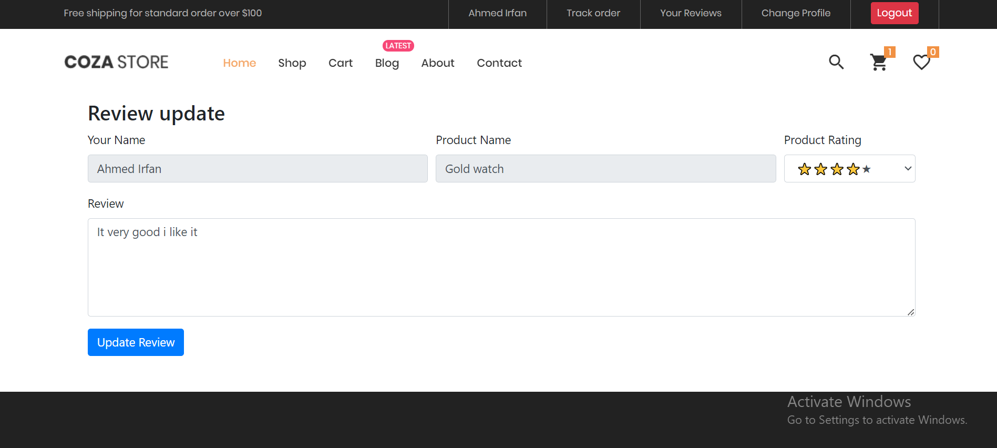
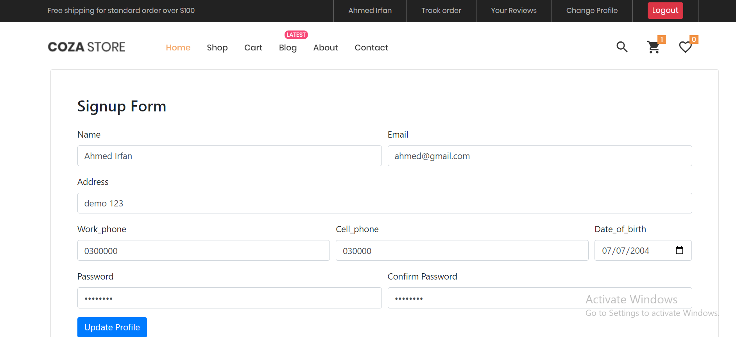
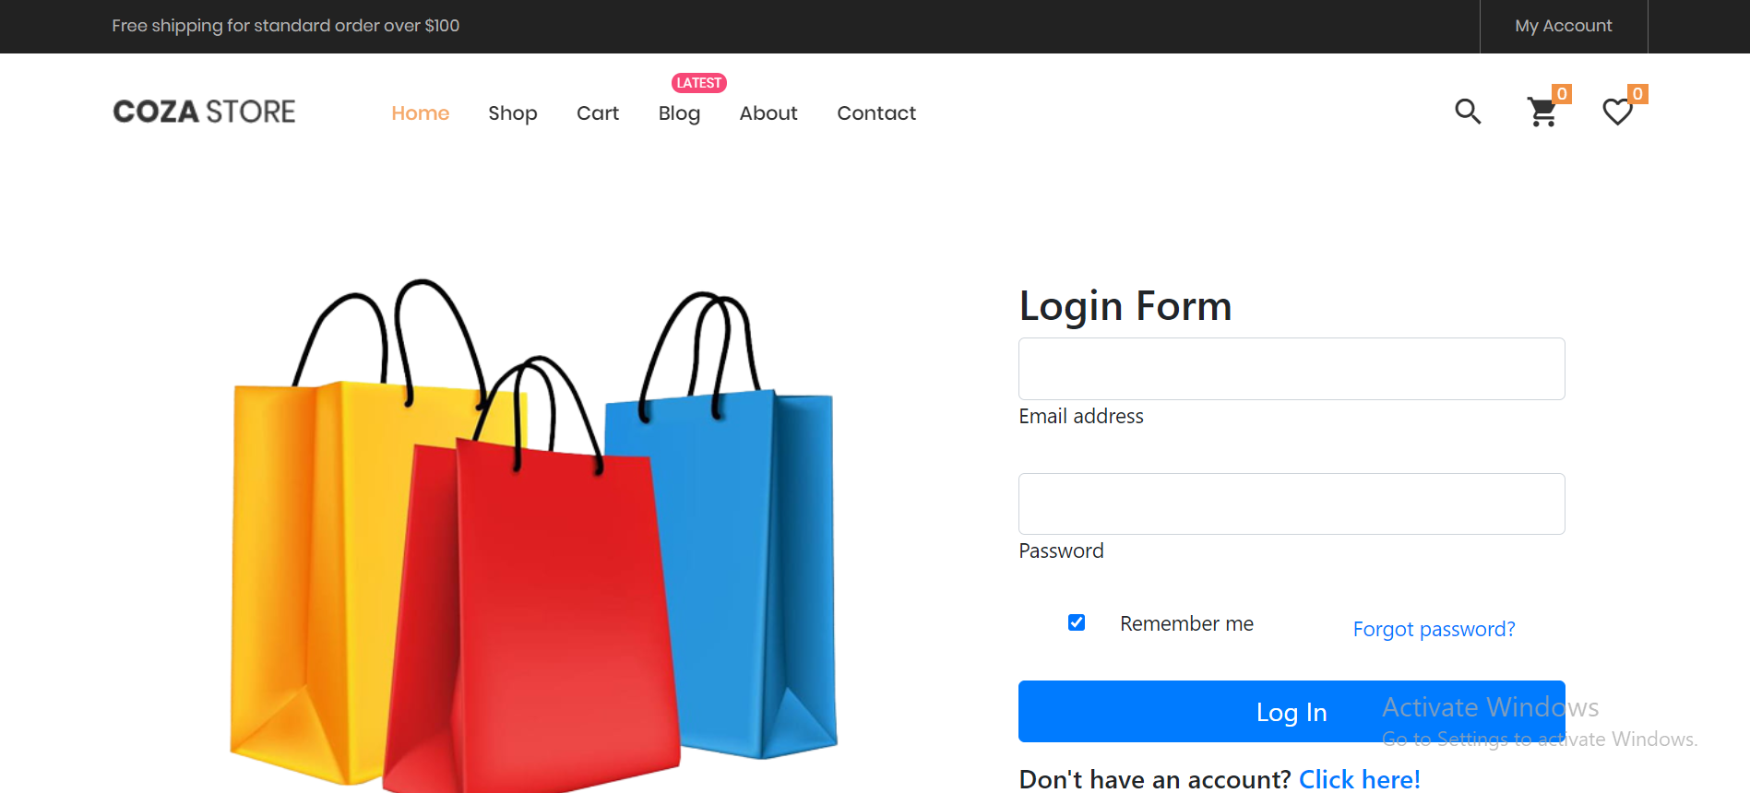
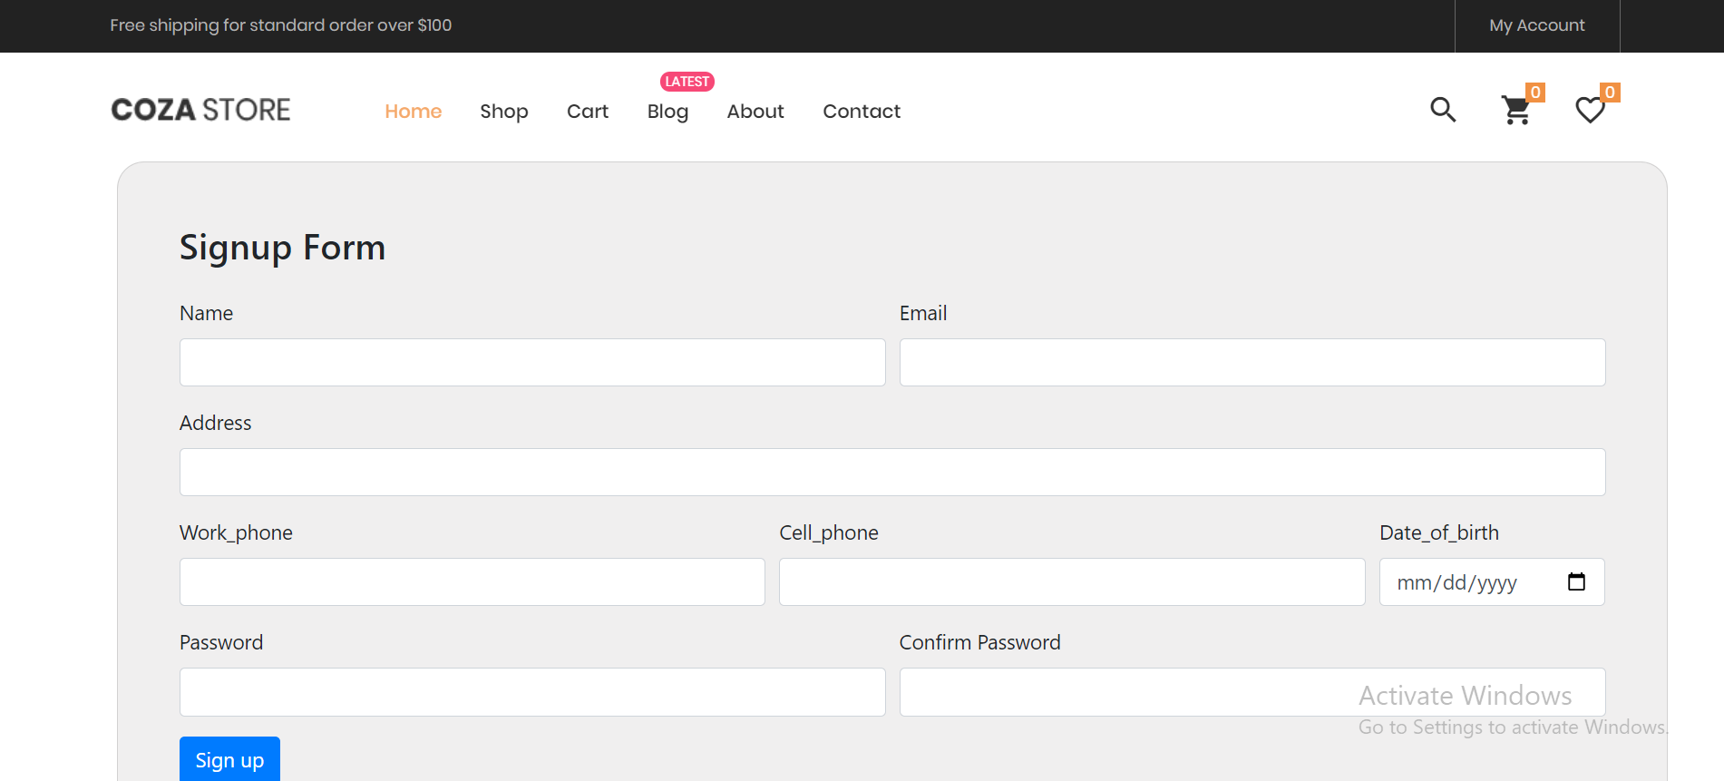
Website
Landing page
Products page
Product detail page
Shopping-cart page
Checkout page
Track orders page
Review submit page
Your reviews page
Review update page
Change profile page
Login page
Signup page

Slide 13
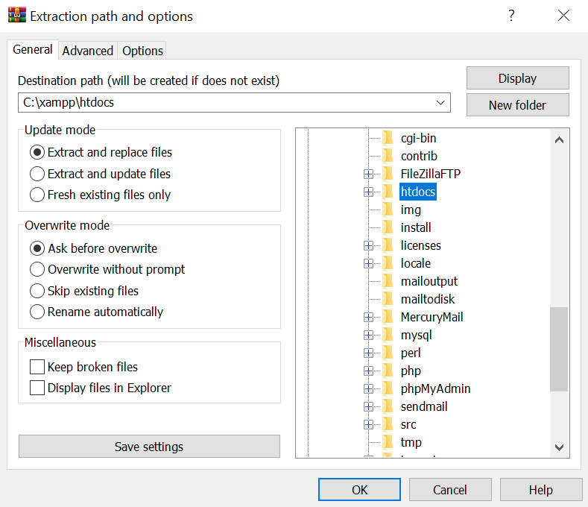
Installation Guide
The installation of this project is very simple and easy!
Step1:Download and Install Xaamp on your pc/laptop by this video tutorial
https://www.youtube.com/watch?v=VCHXCusltqI
Step2:Then Download the project from this link
Step3:Then Install/Extract the project with WinRAR
Extract the project zip file to this directory C:\xampp\htdocs is your xaamp is installed in C drive And D:\xampp\htdocs is your xaamp is installed in D drive and same applies to any drive accordingly

Slide 14
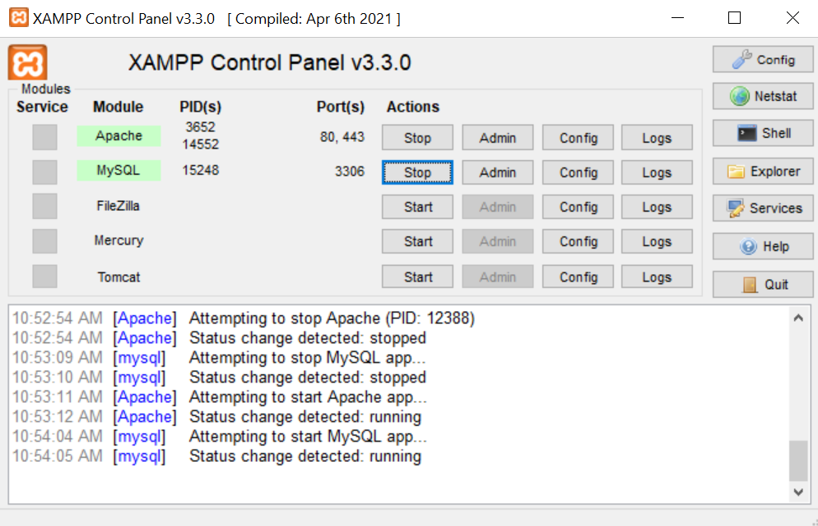
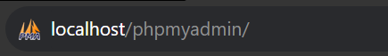
Step4:Open xaamp and turn on Apache and MySQL.
Step5:Now go into any browser and search localhost/phpmyadmin

Slide 15
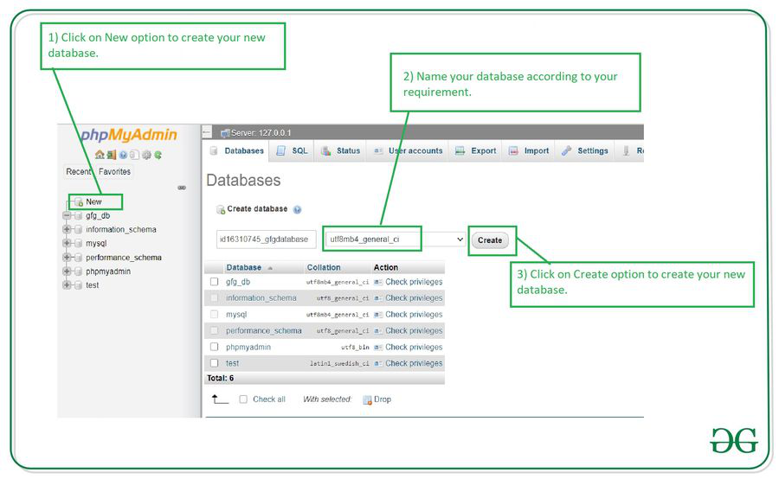
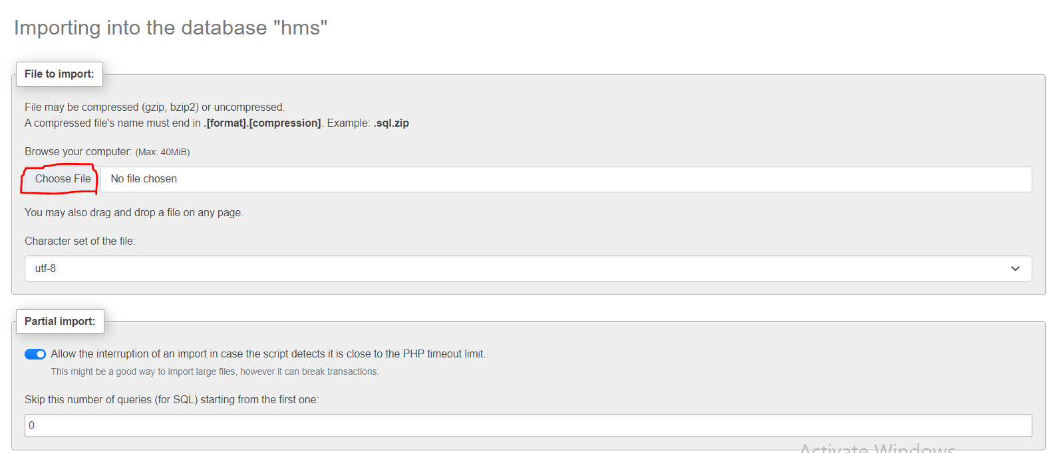
Step5)Then create a new database named pearl_ecommerce
Step6)Now select pearl_ecommerce from sidebar and then click on import option and top

Slide 16
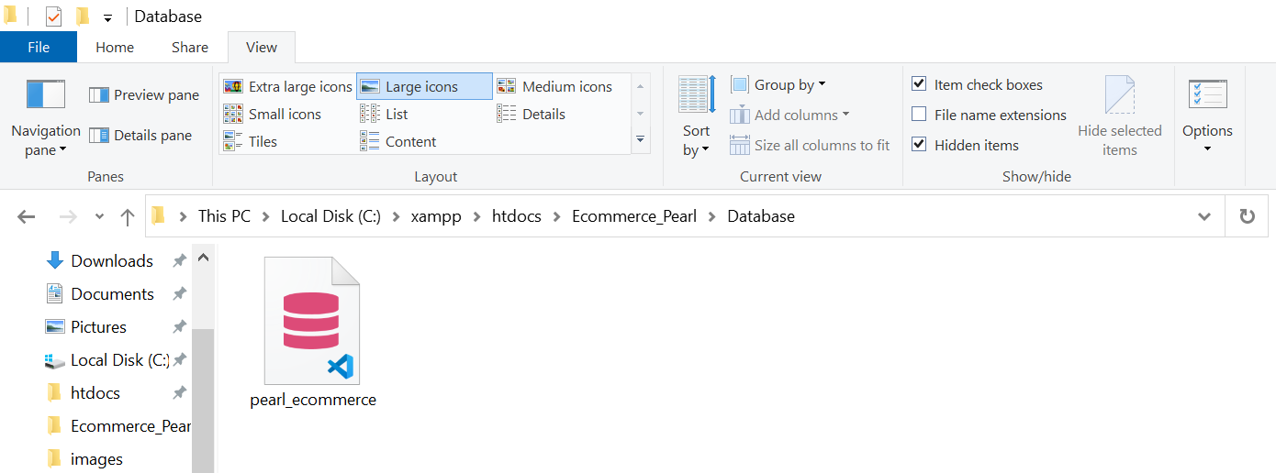
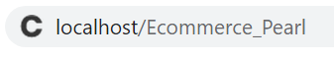
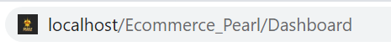
Step7)Then select sql file from Ecommerce_Pearl/Database/pearl_ecommerce.php
Step8)Every time you want to see your website turn on the xaamp follow the same process and then in browser write
localhost/Ecommerce_Pearl
As a customer/Admin
localhost/Ecommerce_Pearl/Dashboard
As an Admin only
And Enjoy your are ready to go!

Slide 17
<?php
echo ‘Thank You’;
?>

